Slide 1

JUPYTER/VOILÀ APPLICATION GENERATOR
Tiago Oliveira (45144)
Tiago Gil (46296)
Course: Engenharia Informática e Multimédia
Advisor – João Beleza
Prj #28

Slide 2
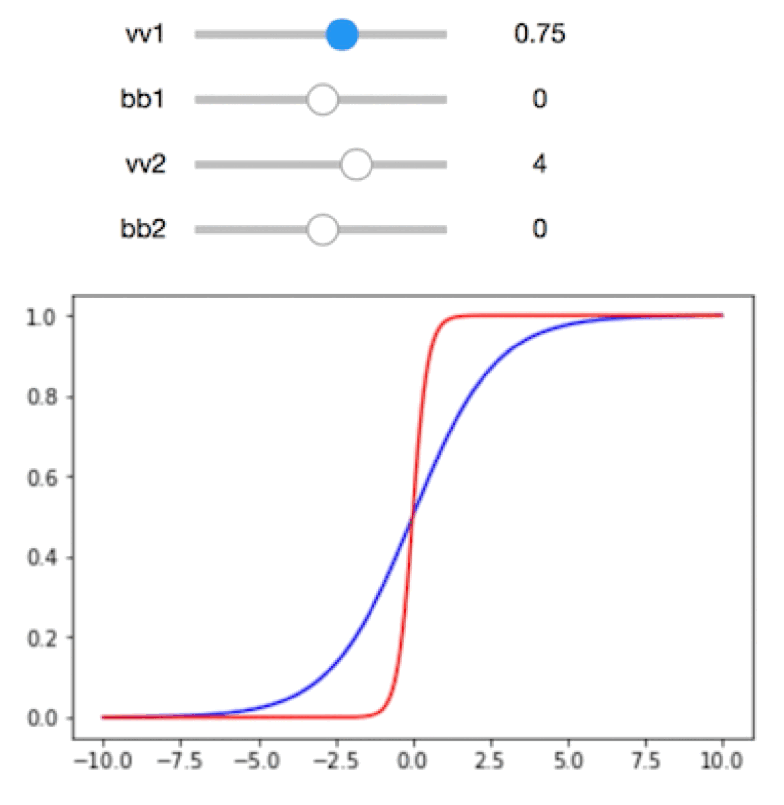
Motivation
Create Voilà applications in an easier and simpler way than it usually is.
From code to low-code.

Slide 3
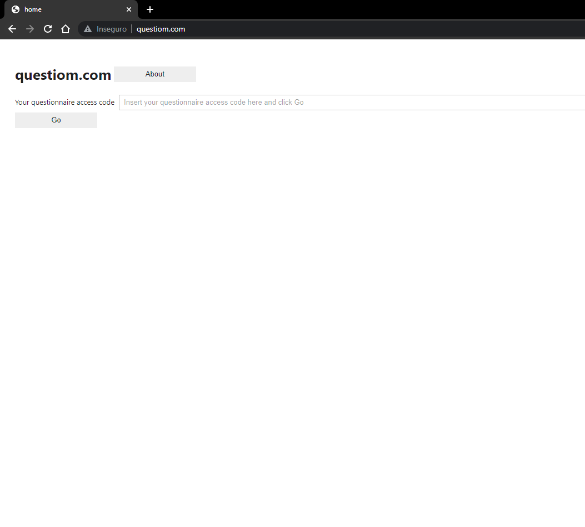
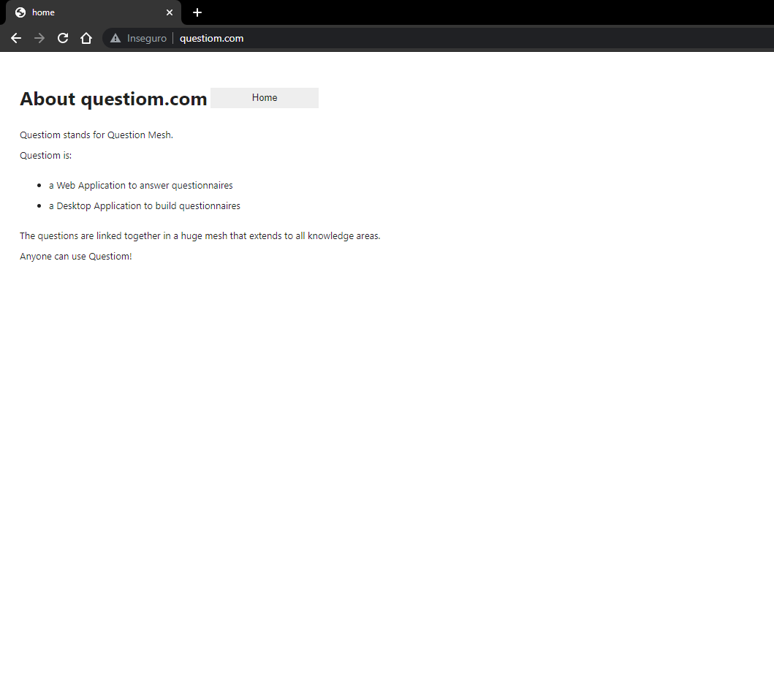
Homework application (questiom.com)

Slide 4
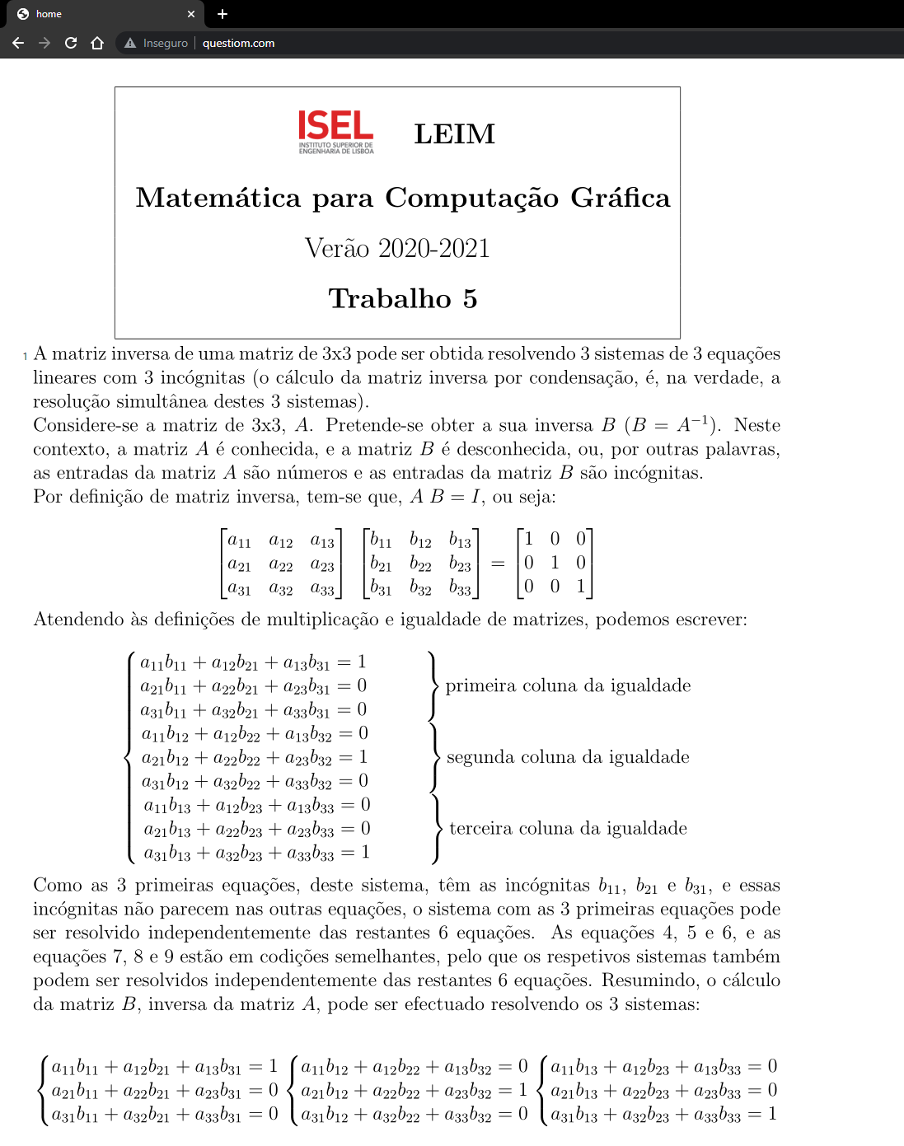
Homework application (questiom.com)

Slide 5




Technologies
Jupyter Notebook is a web application where you can create and share documents that contain code, visualizations and narrative text.
Voilà turns Jupyter notebooks into standalone web applications and dashboards. It also supports interactive widgets.
iPYWIDGETS

Slide 6
What exists
Outsystems
Creatio
Mendix

Slide 7
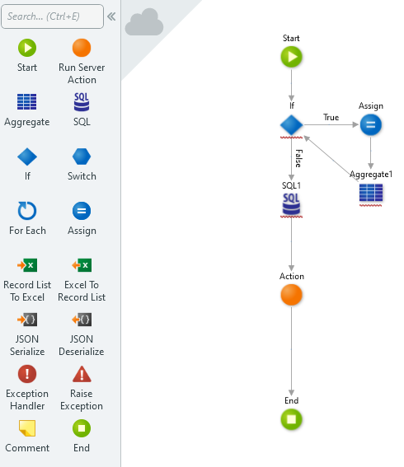
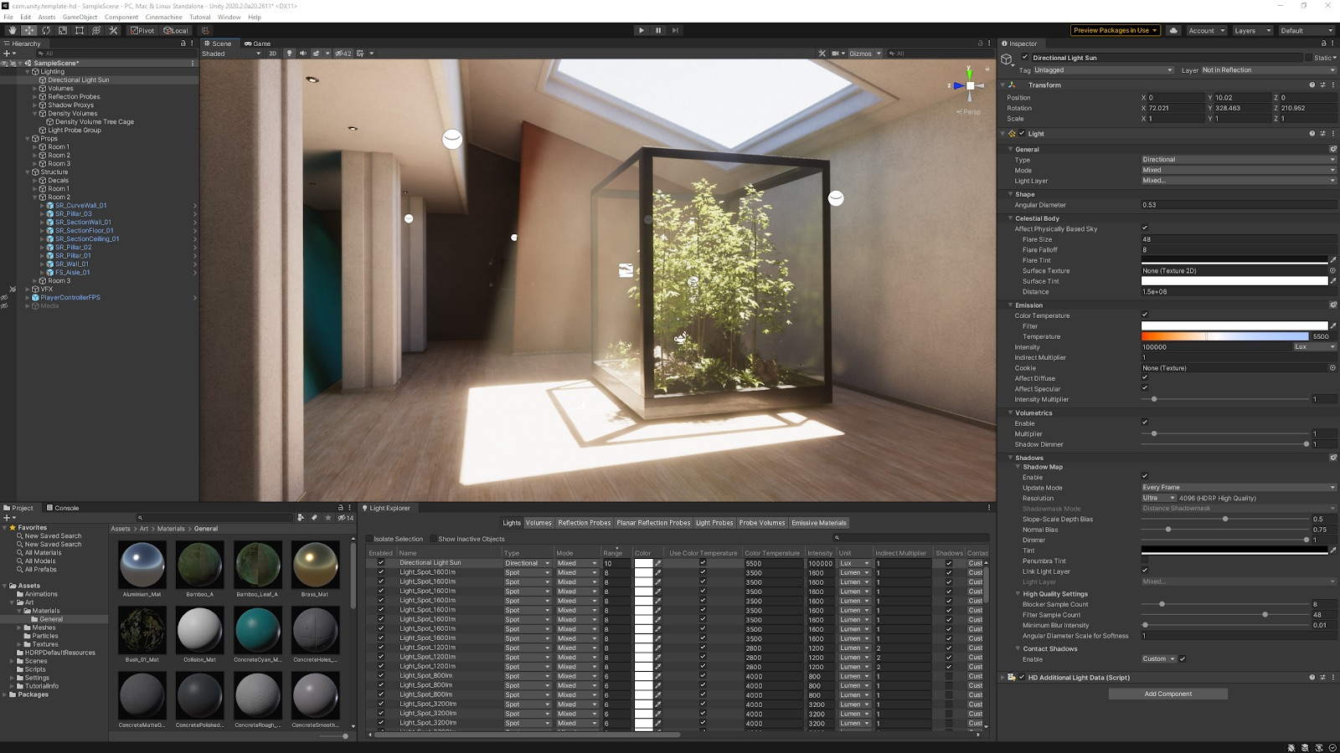
Inspiration
Outsystems
Unity

Slide 8


What we are developing
Low-code Web Application
Library

Slide 9
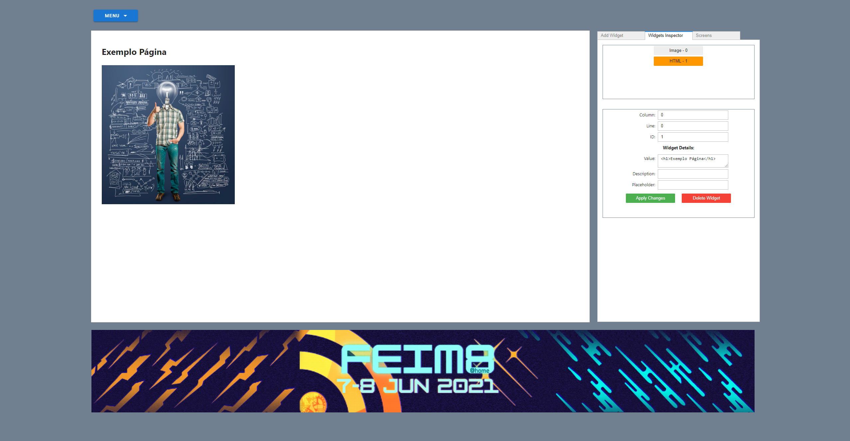
Application
Preview

Slide 10

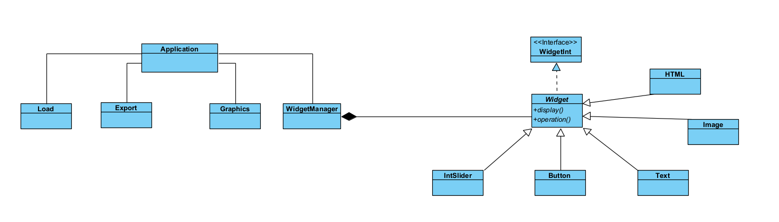
UML Diagram

Slide 11

Library
Develop a library in which the users can add functionalities, new widgets, retrieve their application and create all the back-end they desire their final work to have.

Slide 12
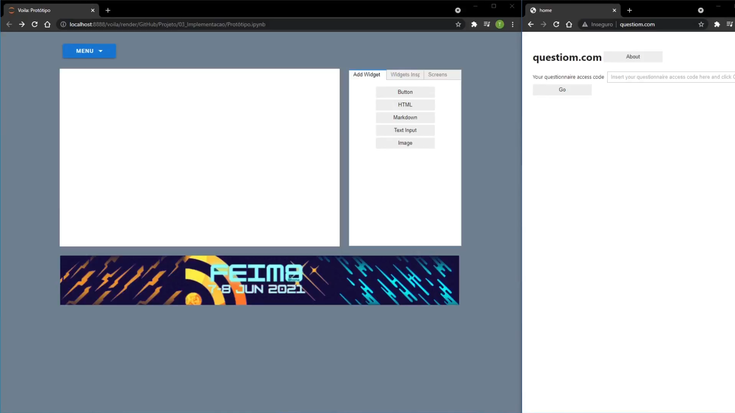
Demo

Slide 13
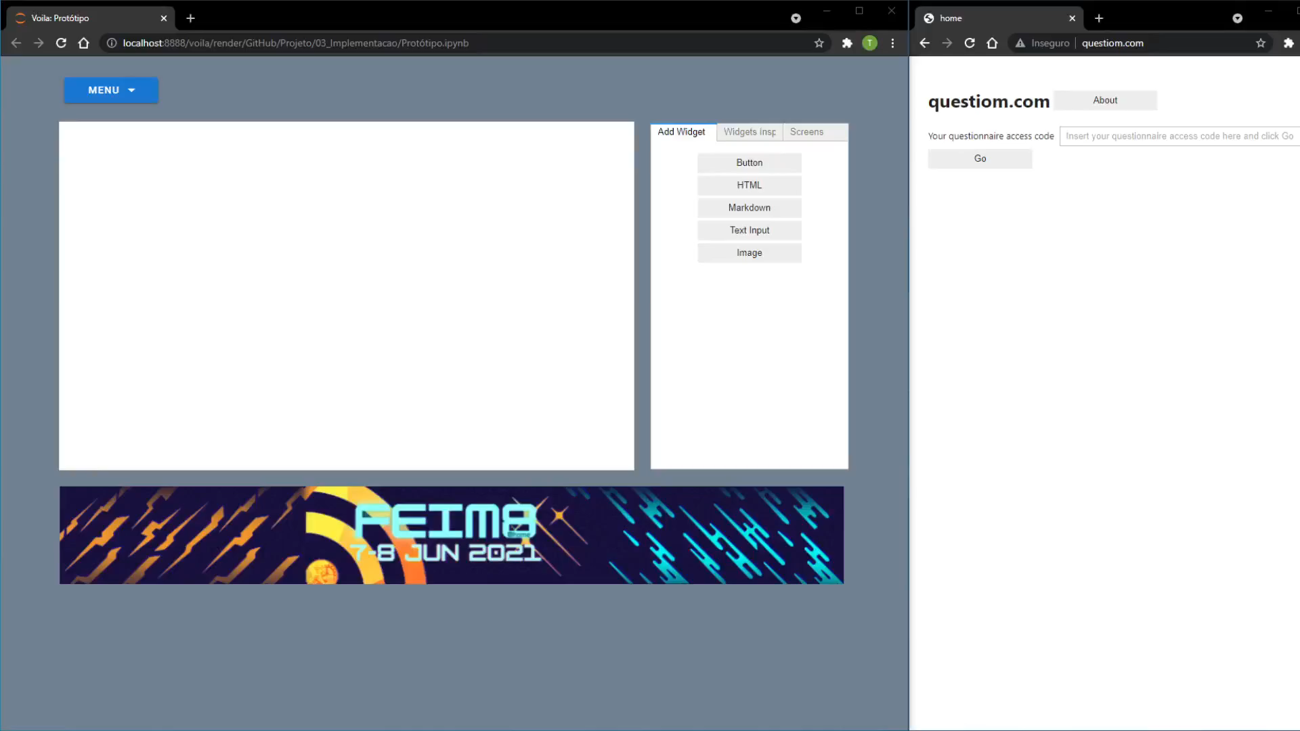

Slide 14
Project goals
Allow widget management;
Interactable UI;
Support up to 30+ widgets (5 for this presentation);
Generate notebook applications;
Edit and export applications;
Extension library.

Slide 15

Thank you!
Tiago Oliveira – A45144@alunos.isel.pt
Tiago Gil – A46296@alunos.isel.pt
ANY QUESTIONS?

